Slide 1
Scientific research + Literature
Research Methods in Data Analytics

Slide 2
Common Research Methods within Data Analytics
Archival Research
Observational – Real Time Data Streams
Experiments
Formal Modelling – Statistical Inference
Project Monitoring
Sentiment analysis
Supervised Learning
Clustering

Slide 3
The Research Process Onion
Positivism
L1:Research Philosophy
Inductive
Experiment
L2:Research Approaches
Mono Method
Survey
Data Collection and Analysis
Cross Sectional
Case Study
Mixed Method
Realism
L3:Research Strategies
Grounded
Theory
Longitudinal
Multi Method
L4:Research Choices
Action Research
Ethnography
Deductive
L5:Time Horizons
Interpretivism
L6:Techniques + Procedures

Slide 4
Data Science Research Method – Archival Research
An ML archival research strategy draws from information that already exists, and meaning is then established through a review of this existing data.
L1:Research Philosophy
Positivism
L2:Research Approaches
L1: Takes an Epistemology philosophy: this method is about “how” we can obtain knowledge and come to understanding.
Positivism: The researcher does not interpret, they only observe. Knowledge can only be acquired through empirical research.
Realism: There is an argument for this viewpoint as the researcher may make assumptions that ML methods may need to adapt as part of ongoing research.
L2: Inductive: The researcher generates theories from research, rather than starting a project with a theory as a foundation. For example, which features drive ML classification in a historical dataset?
Inductive
Archival
Research
Mono Method
Cross Sectional
Realism
Data Collection and Analysis
L3:Research Strategies
Longitudinal
Experiment
L4:Research Choices
L5:Time Horizons
L6:Techniques + Procedures

Slide 5
Data Science Research Method – Archival Research
L3: Strategy: How to collect the data? There are many sources of suitable secondary DS datasets published by;
Government Depts
Industry Bodies
International Agencies
Academia, etc.
L4: Choices: Many DS algorithms rely exclusively on numerical data for statistical analysis. Hence, this research is largely a mono quantitative data collection approach.
L5: Time Horizons: It is common to consider ML research modelling as an exercise on high data volumes in a relatively short timeframe, and hence ‘Cross-Sectional’. However. Some ML research will utilize historical datasets with years of data on a smaller range of subjects.
L1:Research Philosophy
Positivism
L2:Research Approaches
Inductive
Archival
Research
Mono Method
Cross Sectional
Realism
Data Collection and Analysis
L3:Research Strategies
Longitudinal
Experiment
L4:Research Choices
L5:Time Horizons
L6:Techniques + Procedures

Slide 6
Data Science Research Method – Archival Research
L6: Techniques and Procedures. These are the practical steps that need to be handled in order to perform the research. The researcher now has access to historical dataset(s) and must execute an iterative process of;
Data sampling
Data cleansing
Data feature engineering
Data modelling and assessment
L6: Techniques and Procedures. Tool kits for such DS ML research analysis can range from;
DS programming languages – such as Python or R.
ML development environments such as SAS EM or RapidMiner.
Cloud based ML development platforms such as AWS Sagemaker or AZURE ML.
L1:Research Philosophy
Positivism
L2:Research Approaches
Inductive
Archival
Research
Mono Method
Cross Sectional
Realism
Data Collection and Analysis
L3:Research Strategies
Longitudinal
Experiment
L4:Research Choices
L5:Time Horizons
L6:Techniques + Procedures

Slide 7

Supervised Learning
Subcategory of Machine Learning. Uses labeled datasets to train algorithms that can classify data or predict outcomes accurately.
Methods of Supervised learning:
Naive Bayes
Logistic regression
Support vector machine (SVM)
K-nearest neighbor
Decision Tree
Saunders Research Onion
Supervised learning tasks /method are usually applied at L6 ( Techniques and Procedures) of the Saunders Research Onion

Slide 8
Data Science Research Method – Supervised Learning
L1: Epistemology, Positivism
Testing independent data with logical or mathematical proof
L2: Deductive:
Typically used in scientific investigation such as ML models where you start with theory.
L3: Secondary
Large datasets typically required
from third party institutions
L4: Quantitative
Often used for numerical/statistical analysis of data using computational techniques from deductive approach
L5: Longitudinal / Cross Sectional
Many SML methods require large datasets collected over long periods of time, but not always.
L6: SVM / Regression Analysis / Decision Tree
This is where we apply our supervised learning method for prediction/classification
Positivism
L1: Research Philosophy
Deductive
L1: Research Approach
Mono Method
Archival
Research
Data Collection and Analysis
Cross Sectional
L3:Research Strategies
Longitudinal
Experiment
L4:Research Choices
L5:Time Horizons
L6:Techniques + Procedures

Slide 9
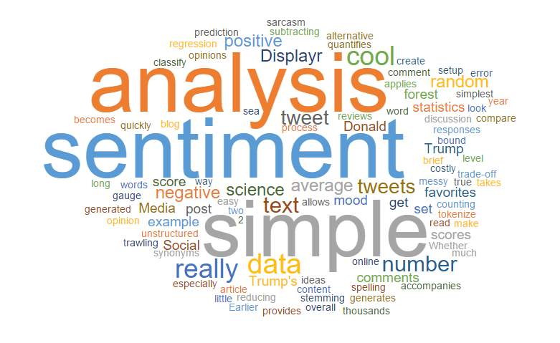
Data Science Research Method – Sentiment Analysis
Sentiment analysis uses a range of data science techniques, including natural language processing, to systematically gain insights from subjective information. A simple example would be creating a word cloud out of tweets about a company's product to gauge customer sentiment towards the product.
Sentiment analysis occupies Level 6 of Saunders' Research Onion (Techniques and Procedures).
Sentiment analysis research can deploy techniques such as deep learning and text analysis across a wide range of domains, from online recommender systems to customer service reviews.

Slide 10
Data Science Research Method – Sentiment Analysis
L1: Epistemology, Ontology: Objectivism, Realism
This type of research deals with things that are assumed to objectively exist and what can we know about them.
L2: Approach
We are gathering data and making inferences from the data, our conclusion is not known in advance.
L3: Research Strategies
Data is often scraped from the web and compiled into a dataset for analysis. The aim is not usually for the analysis to be replicable like an experiment.
L4: Research Choices
Uses both quantitative and qualitative methods. What percentage of reviews are positive? What kinds of opinions do our customers have about our products?
L5: Time horizon
Can be either longitudinal, e.g. analysing changes in sentiment over time, or a cross-sectional snapshot of sentiment.
L6: Techniques + procedures
Rule-based methods, machine learning algorithms, Naïve Bayes, deep learning.
L1: Research Philosophy
Realism
Deductive
L1: Research Approach
Data Collection and Analysis
Cross Sectional
Case study
Mixed
Method
Longitudinal
L3:Research Strategies
L4:Research Choices
L5:Time Horizons
L6:Techniques + Procedures

Slide 11
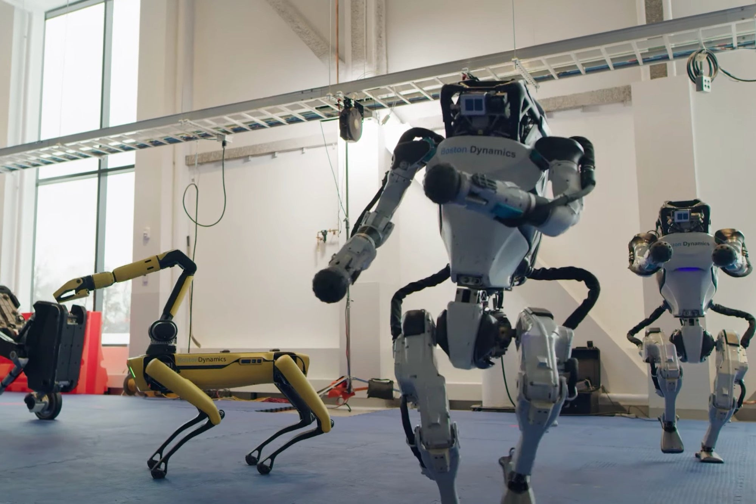
Our Research Questions
Machine Learning to predict Credit Card Fraud?
Machine Learning and Big Data technologies in SMART buildings?
Machine Learning to predict repeat criminal offenders?
Machine Learning to improve traffic noise level prediction?

Slide 12

How Can Machine Learning predict/prevent credit card fraud?
Notes:
NOTE:
To change the image on this slide, select the picture and delete it. Then click the Pictures icon in the placeholder to insert your own image.

Slide 13

Purpose of the Research
Europe saw 17 credit cards with fraud on every 1,000 issued in 2013. By 2016, this had increased to 47 per 1,000 - an increase of 176%.
In that year, the total value of fraud for credit cards issued within the SEPA region was €1.8 billion.
Many organisations have a significant base of employees devoted to fraud investigation, but the volume of transactions requires an automated response to fraud detection.
Financial crime is a constantly evolving threat and there are many academic networks supporting research into more efficient and accurate ML models to detect CC fraud (Example: www.researchgate.net/project/Fraud-detection-with-machine-learning).

Slide 14
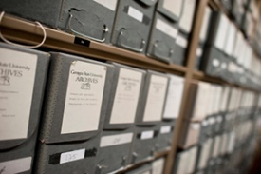

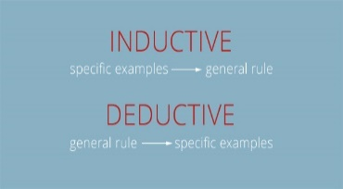

Research Methodology – Improving CC Fraud Detection
L1: Philosophy
POSITIVISM (from Epistemology)
This research works with datasets of known fraud and non-fraud.
The levels of historical fraud are statistically quantified.
ML model testing can be replicated many times to test changes in accuracy.
L2: Approach
DEDUCTIVE
Research begins with the statement: ML techniques can classify a given transaction as fraud or non-fraud.
Credit card transactions for a domain/period are collated and studies to find Fraud patterns.
L3: Research Strategies
ARCHIVAL RESEARCH
CC Fraud research frequently begins with historical datasets with known fraud patterns.
Certain classification algorithms can rate features in transactions to demonstrate strong fraud indicators.
EXPERIMENT
Data scientists iterate through multiple clearly defined ML experiments, using different algorithms and parameters to assess accuracy.
INDUCTIVE

Slide 15
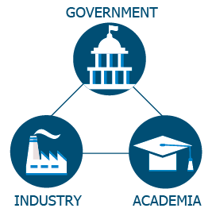

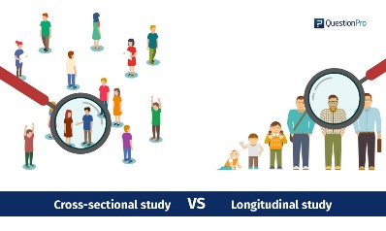

Research Methodology – Improving CC Fraud Detection
L4: Choices
QUANTITATIVE MONO-METHOD
The financial transaction data used in Fraud research is a collection of statistical (numerical) features.
When categorical descriptions are captured, they are usually converted to numerical values.
General text narratives on the transactions are not processed by ML Classification algorithms.
L5: Time Horizons
CROSS-SECTIONAL
The ULB dataset, which is used in several Kaggle projects, is 290K transaction recorded over one month (Sept 2013).^{[1]}
LONGITUDINAL
L6: Techniques and Procedures
METHODS
Access FS Industry or Gov data on Financial Crime.
Examples: MLG in Belgium, PagSecuro in Brazil.
There are published research articles that have used datasets with a transaction window of 18+ months, with ~50M+ transactions.^{[2][3]}
TOOLS + ANALYSIS
ML Development environments to run Classification Models with algorithms such as Isolation Forest for anomaly detection.
- AWS Sagemaker
- AZURE ML Studio etc.

Slide 16

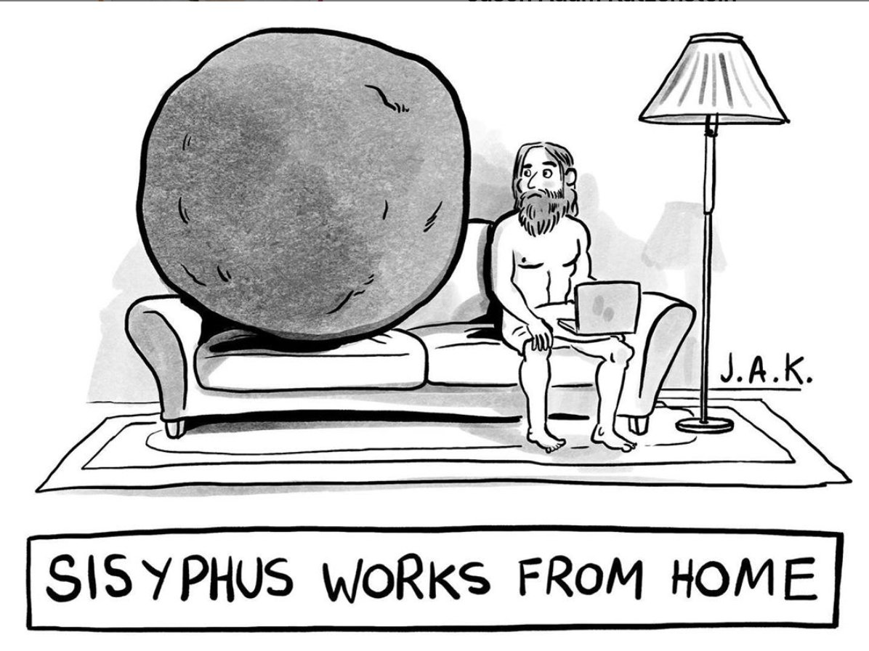
Further Research Considerations
The challenge of building effective automated ML driven systems to detect credit card fraud is constantly changing.
Payment channels and fraudster sophistication continue to evolve.
There will never be a static solution to the problem.
Therefore, research approaches need to constantly iterate with up-to-date datasets and new tools/methods etc.

Slide 17

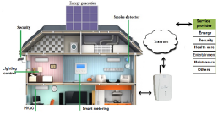
How can machine learning and big data technologies be used in smart buildings?

Slide 18

Purpose of the Research
Building systems are becoming increasingly computerised and technologically sophisticated
Innovations such as smart thermostats, smart electrical appliances such as fridges and coffee machines, and smart meters to predict and balance energy use are transforming our homes and workplaces into responsive, networked environments
As well as providing increased automation and convenience for building users, these systems are generating massive amounts of data that can be used to predict environmental conditions within the building or user behaviour

Slide 19
Research Paper
Leveraging Machine Learning and Big Data for Smart Buildings: A Comprehensive Survey
Authors: Basheer Qolomany, Graduate Student Member, IEEE, Ala Al-Fuqaha, Senior Member, IEEE, Ajay Gupta, SeniorMember, IEEE, Driss Benhaddou, Member, IEEE, Safaa Alwajidi, Junaid Qadir, Senior Member, IEEE,Alvis C. Fong, Senior Member, IEEE
Available from: https://www.researchgate.net/publication/332170623_Leveraging_Machine_Learning_and_Big_Data_for_Smart_Buildings_A_Comprehensive_Survey [accessed Feb 13 2022].

Slide 20
Research Methodology
L1 Philosophy
Objectivism (from ontology)
Social phenomena exist independently of social actors
L2 Approaches
Deductive approach
Starts with a research question and attempts an answer
L3 Strategies
Archival research: looking at existing research papers etc.
Case study: investigating specific technology applications in-depth

Slide 21
Research Methodology
L4 Choices
L5 Time Horizons
Primarily a survey of the field at present moment
Therefore a cross-sectional analysis
Mixed-method
Both quantitative and qualitative aspects to the research
L6 Techniques & Procedures
Pilot case (case study)
Literature review

Slide 22

Can MACHINE LEARNING help in predicting repeat offenders?

Slide 23

Purpose of Research
Most of the current research available in this area exclusively focus on the space-time forecasting rather than techniques to identify likely repeat offenders.
If repeat offenders account for majority of crime occurrence, implementing people/profile-specific deterrence practices may yield equally beneficial prevention outcomes.
Applying the importance of this research to Ireland, study completed in by CSO shows a rate of recidivism for prisoners released during 2012 was 45.8%. within three years of their release from prison.
Main research outcomes include:
accurately predicting repeat offenders amongst a group of known offenders.
create a “profile” which uses known attributes of likely repeat offenders.

Slide 24
Research Methodology
L1 Philosophy
Deductive
Positive Epistemological
Existing theory is proposed that machine learning can help in identifying reoffenders using a top down approach to validate the authors theory
General theory is deducted down to specific facts and implications, e.g. reasoning for persistent reoffending and targeting resources
Objective study using official statistics obtained from the Bejing Municpal Public Security Bereau (BMPSB)
Social facts are used with scientific techniques to identify correlations and deduct possible causes for reoffending.
L3 Strategy
Data is obtained from existsing records residing in the Crime Recording System in BMPSB
Relationships and patterns are investigated from this existing database used within the study.
L2 Approach
Archival Research

Slide 25
Research Methodology
L5 Time Horizon
Cross Sectional
L6 Technique and Tools
Data Collection – Secondary Data: Sample offence data from Crime Recording Syste in BMPSB (695 row only)
Structured observation data from BMPSB is the primary source of data used in this study
L4 Method Choice
Mono Method - Quantative Research
Relationships and correlation experiments performed on prisioner dataset to evaluate influence of indepenent features on target feature.
Dataset is a snapshot view of existing indivisuals incarcerated at the time of the study.
This study deliberatly removes itself from the space time dimesions of similar studies to compare results using only limited social features at one point in time.
Tools/Materials: WEKA, Binomial Logistic Regression Modelling, Litrature Review
Analysis: Mainly working with qualative data. Performing ROC, Precision and Recall analysis to evaluate predictive model results on BLRM.

Slide 26
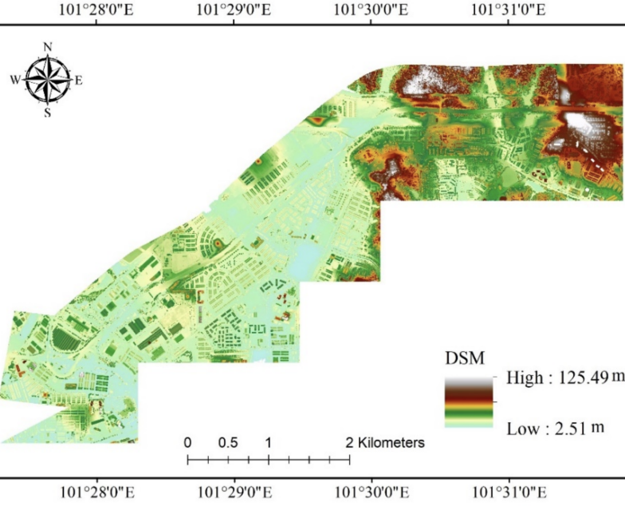
How can machine learning and GIS be used to predict traffic Noise?
Notes:
NOTE:
To change the image on this slide, select the picture and delete it. Then click the Pictures icon in the placeholder to insert your own image.

Slide 27
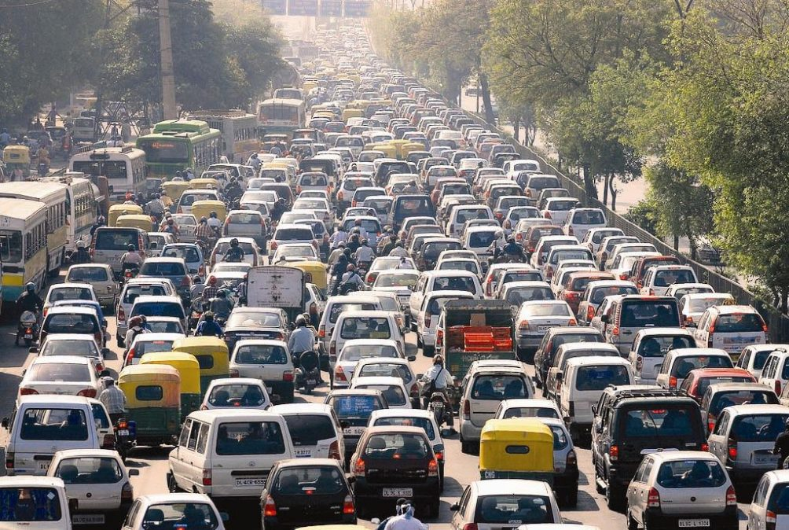
Purpose Of The Research
Traffic noise in urban areas is increasing which can have a detrimental effect on peoples health and the wellbeing of the local community.
Noise level depends on factors such as road type, surface, road texture, road age, wind speed, land use, tire type and engine type
Collecting noise level data is both expensive and time consuming
Can machine learning models be used to predict traffic noise based on a smaller data set of collected information?

Slide 28
Research Methodology
Philosophy
Positivism (from Epistemology)
A question is posed which can be tested and confirmed using reproducible methods.
Approaches
Strategies
Experimental
Deductive
A theory questions if machine learning can improve traffic noise prediction.
The research sets out to answer this question.
Emphasis on quantifiable results from modelling outcomes.
The tests are performed on quantified data.
Data collected is run through multiple iterations of ML models to hyper-tune parameters for best results.

Slide 29
Research Methodology
Method Choice
Multi Method - Quantitative
LUR models collected data on information such as road type, land use type, proximity to petrol station etc.
Time Horizon
Techniques and Tools
Methods
Observational, onsite data collection.
Experimental, predictive modelling.
Cross Sectional
Noise predictor data was collected over a short period of time.
LUR data sources provide data of the area at a single point in time.
Numeric traffic noise predictors were collected in the study area.
Tools/Analysis
Machine Learning models (LR, DT, RF, SVM) developed in python. Geographic LUR models.
Sound meter, anemometer, traffic tallies, GIS observation data.

Slide 30
References
Ceronmani Sharmila, V., R., K., R., S., D., S. and R., H., 2019. Credit Card Fraud Detection Using Anomaly Techniques. 2019 1st International Conference on Innovations in Information and Communication Technology (ICIICT), [online] 1(1), pp.1-4. Available at: <https://ieeexplore.ieee.org/document/8741421> [Accessed 11 September 2020].​
Bhattacharyya, S., Jha, S., Tharakunnel, K. and Westland, J., 2011. Data mining for credit card fraud: A comparative study. Decision Support Systems, 50(3), pp.602-613.​
Lima, R. and Pereira, A., 2017. Feature Selection Approaches to Fraud Detection in e-Payment Systems. Lecture Notes in Business Information Processing, [online] pp.111-126. Available at: <https://www.researchgate.net/publication/313731885_Feature_Selection_Approaches_to_Fraud_Detection_in_e-Payment_Systems> [Accessed 11 September 2020].
Al-Fuqaha, A., Alwajidi, S., Benhaddou, D., Fong, A., Gupta, A., Qadir, J., Qolomany, B. (2019). Leveraging Machine Learning and Big Data for Smart Buildings: A Comprehensive Survey. IEEE Access, vol. 7, pp. 90316-90356. doi: 10.1109/ACCESS.2019.2926642.​
M. R. Alam, M. B. I. Reaz, M. A. M. Ali, (2012). A Review of SmartHomes Past, Present, and Future. IEEE Transactions on Systems, Man, and Cybernetics, Part C (Applications and Reviews), vol. 42, no. 6, pp. 1190–1203. doi: 10.1109/TSMCC.2012.2189204.​
B. Beda, M. V. Moreno, A. F. Skarmeta, and M. A. Zamora (2014). How can We Tackle Energy Efficiency in IoT Based Smart Buildings? Sensors (Basel, Switzerland), vol. 14, no. 6, pp. 9582–9614. doi: 10.3390/s140609582.

Slide 31
References
Chen, Peng & Kurland, Justin & Shi, Shaochong. (2019). Predicting Repeat Offenders with Machine Learning: A Case Study of Beijing Theives and Burglars. 118-122. 10.1109/ICBDA.2019.8713192. ​
Central Statistics Office (2019), Prison Recidivism 2011 and 2012 Cohorts, 24 September 2019, 11am. https://www.cso.ie/en/releasesandpublications/ep/p-prir/prisonrecidivism2011and2012cohorts/. ISSN: 2009-7076​
Babbie, Earl R. The Practice of Social Research. 12th ed. Belmont, CA: Wadsworth Cengage, 2010; Muijs, Daniel. Doing Quantitative Research in Education with SPSS. 2nd edition. London: SAGE Publications, 2010.​
IBM Cloud Education, Supervised Learning. 19 August 2020. https://www.ibm.com/cloud/learn/supervised-learning
Adulaimi, A. A. A., Pradhan, B., Chakraborty, S., & Alamri, A. (2021). Traffic Noise Modelling Using Land Use Regression Model Based on Machine Learning, Statistical Regression and GIS. Energies, 14(16), 5095. MDPI AG. Retrieved from http://dx.doi.org/10.3390/en14165095

Slide 32
Presenters
Garrett Drummond - C09640401
Rachel Donnelly - C06543201
Marc O'Neill - C03446824
Ciaran Finnegan - D21124026

